Slide 1









Identity
Insights
Notes:
Goede avond…
Vanavond ga ik het resultaat van een paar maanden werk met jullie delen. Een project waar ik aan gewerkt heb.. Wat ik naam (en met dan aan AI) een logo gegeven heb… ik noem het Identity Insights…
Een tool.. Een puzelstukje wat wat mij betreft ontbreekt in de Microsoft EntraID oplossing. ..

Slide 2


Agenda
Intro
Assumptions
What is Identity Governance?
Why is this hard?
Solution roadmap
Entra Identity Governance
Identity Insights
Demo

Slide 3
Intro
Wim van den Heijkant
Aged 39, happily married, father of two.
Full time Microsoft Identity consultant for over 15 years now. MIIS, ILM, FIM, MIM, BPOS, Azure AD, EntraID
Co-founder and proud member of Identity Consultancy “Maatschap Fortigi”

Slide 4
Intro
Working with Port of Rotterdam
Cool place to work, allowed me to share, to open source:
https://github.com/fortigi/IdentityInsights

Slide 5
Assumptions
You have done the basics
Automated provisioning (from HR)
MFA, Conditional Access
Single Sign-On & SCIM
Just in Time Access to critical stuff
On a path to transition from AD to EntraID
What's next… Identity Governance

Slide 6
What is Identity Governance?
Identity Governance & Administration (IGA) “Governance is the process of making and enforcing decisions”
Finding a way to “know” that the right users have the right permissions at the right time.
1) https://en.wikipedia.org/wiki/Governance

Slide 7



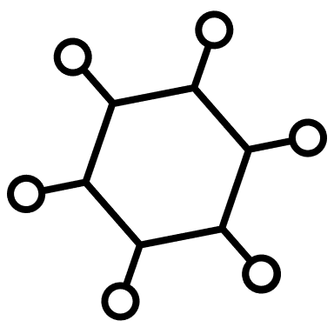
Why is this hard?
Users
Permissions
Lots of combinations

Slide 8




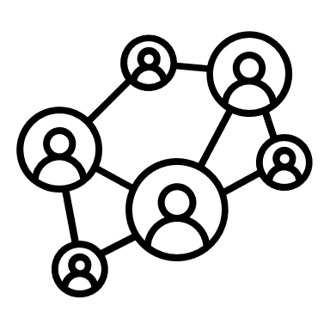
Why is this hard?
Users
Permissions
Lots of combinations
Do you know why we have a user?
Source of record
Chain of responsibility
Not easy, but we can do this!

Slide 9

Why is this hard?
Users
Permissions
Lots of combinations
Do you know why we have a user?
Source of record
Chain of responsibility
Not easy, but we can do this!
Do you know what a permission is for?
Link to Application
Link to team / owner
Really hard, be we can try..

Slide 10

Why is this hard?
Users
Permissions
Lots of combinations
Do you know the right users have the right permissions?
Lots of combinations
Lots of changes over time
Multiple people might have an opinion

Slide 11
Our data…
4663
8815
159945

Slide 12
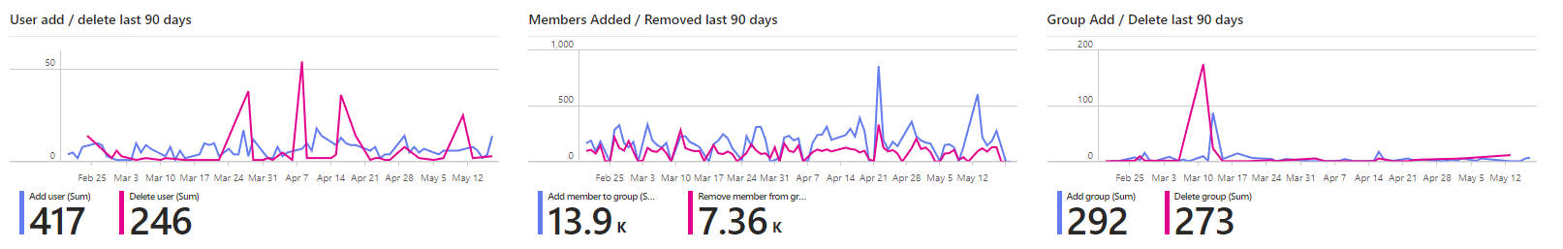
Our data…
4663
8815
159945
39 changes last week
1976 changes last week
28 changes last week

Slide 13
As I said…
Users
Permissions
Lots of combinations
Lots of combinations
Lots of changes over time
Without “help” it is impossible to know if the right users have the right permissions.

Slide 14
The challenge
How to “know” that the current (and future) user / permission combinations are correct.

Slide 15
Solution roadmap
1. Start with “knowing” you have the right users
Source of Authority
Chain of responsibility
2. Proceed with “knowing” your permissions
Link to app
Link to team/owner
Removing (a lot) of groups
3. Next, split the user/permission combinations into parts
Finding clusters (‘role mining’)
Create roles / access packages

Slide 16
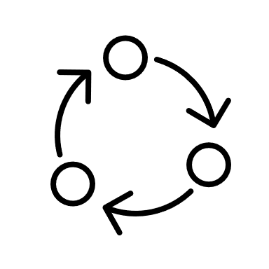

Entra Identity Governance
Life cycle workflows
Access Governance
Access packages
Request & Approve
Dynamic
Governance
Access Review
Approval logs
Grace periods

Slide 17
Entra Identity Governance
Start with “knowing” you have the right users
Source of Authority
Chain of responsibility
Proceed with “knowing” your permissions
Link to app
Link to team/owner
Removing (a lot) of groups
Next, split the user/permission combinations into parts
Finding clusters (‘role mining’)
Create roles / access packages

Slide 18
Insights are missing..
AI will solve all this right?
Well possibly… I have heard about some cool features coming..
What did we use before AI to solve for these kinds of challenges?
BI..... PowerBI…
Introducing Identity Insights

Slide 19
Identity
Insights

Slide 20






Identity Insights
Scripts collect data
Scheduled in automation
JSON Files
Stored in Blob Storage
Joined & structured
Using Power Query
Insights using
PowerBI

Slide 21
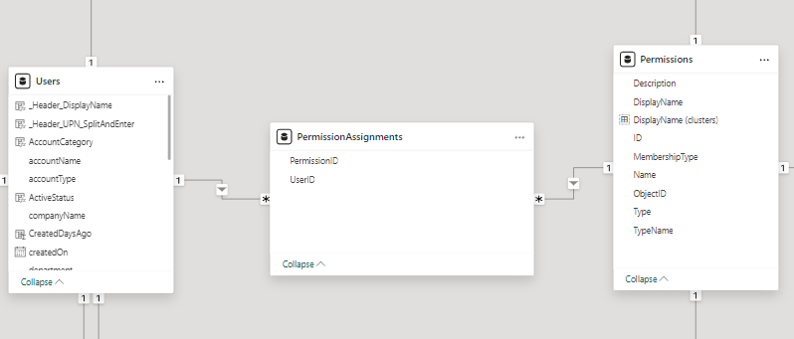
Identity Insights
Data model
There is no ID in EntraID, there is only user.

Slide 22
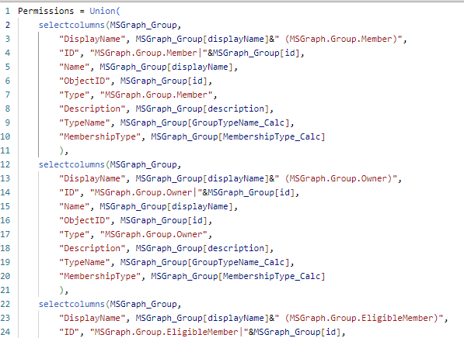
Identity Insights
Unions & Mappings make it flexible

Slide 23
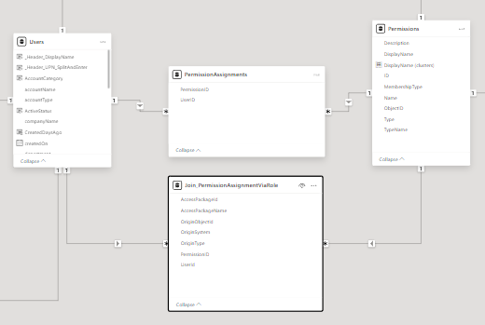
Identity Insights
Permission Assignment via Access Package

Slide 24
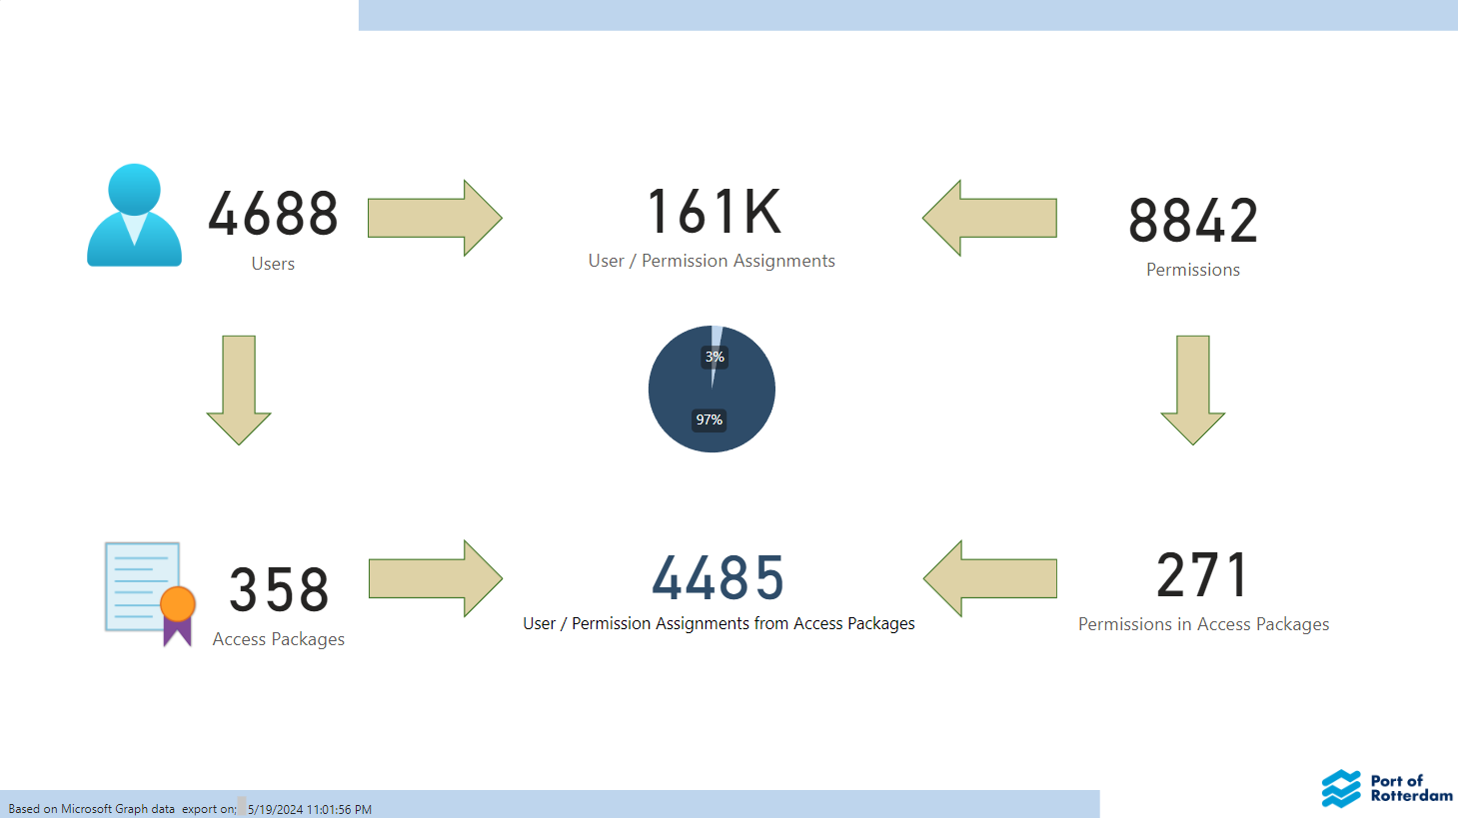
Identity Insights

Slide 25
Role mining
Finding a sets of permissions that users matching a set of criteria have in common
Example, which permissions can we (auto) assign to;
all employees?
all users in department y
all users in department y with job title x
This allows us to “know” for this set of user / permission combinations that they are correct.

Slide 26
Role mining
Role mining in two steps;
1. Create a “filter” selecting a sub-set of your users and/or permissions
2. Find which permissions these users have in common
Look at percentages (Role %)
% of users with permission (in this scope)
% of users without permission (in this scope)
% of users with this permission (outside of this scope)
% role candidate
Looking for patterns...

Slide 27
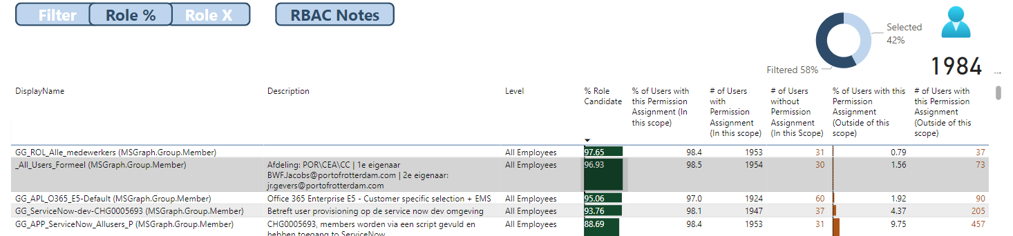
Role mining
Users in Filter: 1984

Slide 28
Role mining
Users in Filter: 1984
98,4% of user in filter have this permission (Total 1953)
31 do not.. Would get this permission if auto assigned

Slide 29
Role mining
Users in Filter: 1984
98,4% of user in filter have this permission (Total 1953)
31 do not.. Would get this permission if auto assigned
37 users have this permission but are not in the filter.

Slide 30
Role mining
% Role candidate 97,65

Slide 31
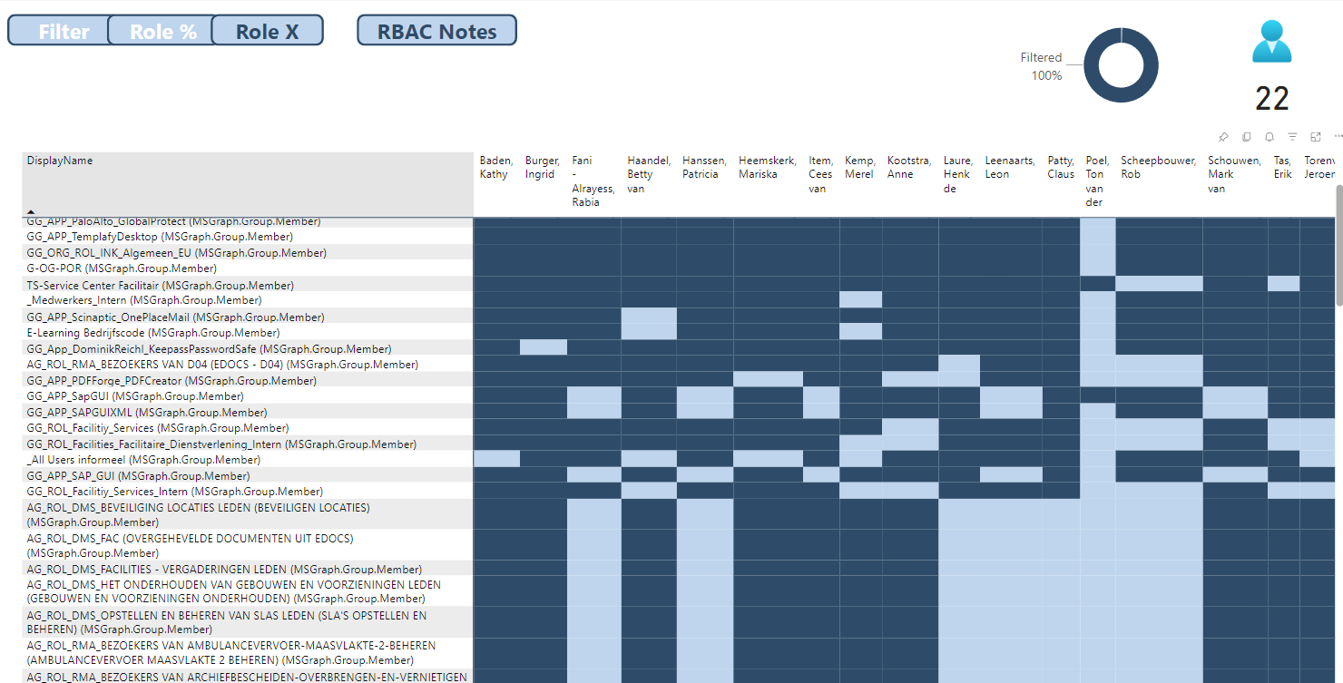
Role mining

Slide 32
Role mining

Slide 33


Filter noise.. Add notes
PowerBI
Excel
Adding notes to your Power BI data
Notes:
Slide toevoegen.. Van data model….

Slide 34
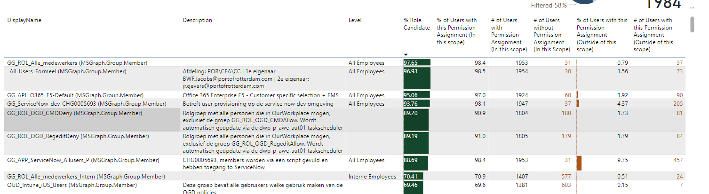

Slide 35

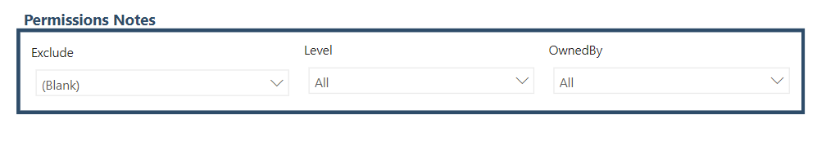
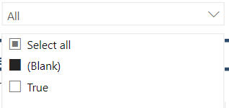

Slide 36
Demo

Slide 37
https://github.com/fortigi/IdentityInsights

Slide 38
Identity
Insights

